Slide 1

Becoming a Program Evaluator

Slide 2
The Big Picture
ABET accredits 4,674 programs at 920 institutions in 42 countries/areas
At present, ABET has more than 2,200 experts
  From academia, industry, government and the profession
  Experts serve many roles in ABET
Quality and consistency of the accreditation process is derived from strength of the PEV pool

Slide 3
A Growing Need for PEVs
Projected need for up to 2,500 experts within five years
Major ABET priorities:
  Work with societies to recruit PEV
  Refine/improve training
  Retain new PEVs

Slide 4
Why Become an ABET Expert?
Ensure global program quality
Contribute to technical education program delivery
Individual professional development
Gain best practice experience from programs other than one’s own
Influence academic conversation and relationship with industry

Slide 5
Program Evaluator (PEV)
Competency Model
Program Evaluators are the “face of ABET” and need to:
  Provide the highest quality review of individual programs
  Improve consistency of evaluators’ work
  Ensure PEVs are adequately prepared to be effective team members and reviewers

Slide 6
What Is a Competency Model?
  A set of behaviors that encompass the knowledge, skills and abilities of highly successful Program Evaluators

Slide 7
PEV Competencies
Technically Current
Effective Communicators
Professional
Interpersonally Skilled
Team-Oriented
Organized

Slide 8
How is the ABET PEV Competency Model Used?
Recruiting
  Inform nominators and candidates of expectations
Selection
  Assess candidates against criteria and competencies
Training
  Competencies needed for successful PEV training
Performance Appraisal
  Standards/expectations for continuous improvement
Competency models are standard practice in the industries served by ABET programs.

Slide 9
What’s in It for You?
Help ensure the quality of higher education
Unique professional development opportunity
  Use your specialized knowledge to improve educational experience for thousands of students
Network with other professionals
  A great source of experience-based knowledge
Keep up to date and have input on the criteria
Service to the community of people who develop and maintain quality education
Serve your profession, “give back”

Slide 10
What’s in it for You?
For Those from Academia
  Help other institutions/programs improve
Helps you prepare for an ABET visit
See accreditation from the “other side”
  What happens to your Self-Study Report after it leaves your institution?
  What kind of issues may be raised?
  How you can make the PEV’s job easier (and in the process make your visit go more smoothly)?
  How can you reduce unnecessary anxiety about visits?
  How are other schools handling some of the issues you find to be difficult?

Slide 11
PEV Pre-Visit Effort
Pre-Visit (10-28 hours)
  Training updates (1-2 hours)
  Reviewing the Self-Study Report (4-8 hours)
  Completing required forms (2-6 hours)
  Participating in team conference calls (2-4 hours)
  Communicating with the program and Team Chair prior to the visit (1-8 hours)

Slide 12
PEV Visit and Post-Visit
Campus Visit: Sunday through Tuesday
  Travel Saturday, Tuesday evening
  Review materials
    Based on your assessment of Self-Study Report
  Tour facilities
  Meet and interview faculty, students and others
  Participate in team meetings
    Extensive discussions –
    team-based decisions
  Write short report of findings
Post Visit (1-2 hours)
  As requested by the Team Chair
  No direct contact with school after visit

Slide 13
PEV Annual Cycle Experience
360° review of each visit
  PEVs evaluated by Program Chair and Team Chair
  PEVs evaluate other PEVs and Team Chair
  Results provided to PEV after completion of review cycle
Update status each spring
  Code of conduct agreement
  Availability for visits
  New conflicts of interest
Training
  Refresher training
  Just-in-time training prior to each visit
  ABET Workshops and Symposia (discounted registration for PEVs)
Repeat as desired

Slide 14
Potential ABET Career
Trainee
Observer
Program Evaluator
Accreditation Commission Member
  (i.e., team leader)
Accreditation Commission Executive Committee Member
Board of Directors/Delegates, Area Delegation Member
Board of Directors Officer

Slide 15
Initial Training
Three Separate Steps
Online learning experience
Face-to-face facilitated instruction
Society-specific training (if applicable)

Slide 16
Online Training
Online portion of PEV Candidate Training typically takes up to 20 hours
Requires written work and the completion of three end-of-module quizzes

Slide 17
Face-to-Face Training
Pre-Work (4-8 hours)
  Review of process and requirements
  Evaluation of partial Self-Study Report
  Mentor support/feedback
Face-to-Face Training
(~2 days with travel)
  Full-day Saturday, half-day Sunday
  Teams of 5-6 PEV candidates with Support Facilitator
  Variety of activities
    Presentation of information
    Team activities
    Play-acting demonstrations
    Individual statement writing exercise

Slide 18

Personal Travel Expenses
ABET pays all reasonable and appropriate travel expenses
  Face-to-Face Training
  Campus Visits

Slide 19

Training Period
The entire PEV candidate training process begins in March and ends in June.
The online training must be completed at least three weeks before the Face-to-Face Training.

Slide 20
Additional Training Notes
New PEVs are assigned a mentor who provides feedback throughout training.
Support Facilitator at the Face-to-Face Training also provides feedback.
Some societies require an observer visit before a PEV serves on an actual visit.
PEVs do online Just-in-Time Training prior to visits each year as a reminder about tasks and changes.
Professional Development Hours (PDHs) can be awarded for participation.

Slide 21
Start With Online Application www.abet.org
When you apply, you must select the appropriate commission.
  Applied and Natural Science Accreditation Commission (ANSAC)
  Computing Accreditation Commission (CAC)
  Engineering Accreditation Commission (EAC)
  Engineering Technology Accreditation Commission (ETAC)
Your member society will review your application and contact you if you are selected for training.
  Each society has different selection cycle and may take several months.

Slide 22
Nomination by Your
Professional / Technical Society
PEV candidates who successfully complete both the online training and the Face-to-Face Training may be nominated by his or her member society to serve as a Program Evaluator.
Some societies require additional specialized training and conduct that separately, often online.

Slide 23
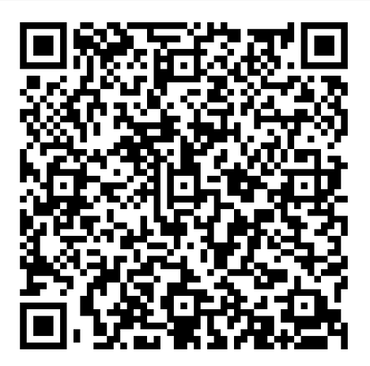
Link to Application

Slide 24

Thank you!

